Slide 1
Sports Hub (Phase-2)
Buy tickets for different sports events
CSP-584
Team No. 33
Amitdeb Bhattacharya A20402789
Baltej Singh A20444488

Slide 2
Description:
Allows customer to register and login to purchase tickets online for sports event.
Customer can also purchase tickets for different locations.
Customer can see upcoming schedule for the games.
Sends e-ticket by email to customer after successful purchase of ticket.
Allows customer to view purchase history.

Slide 3
Technologies:
HTML
Bootstrap
JavaScript
Java
JSP
Servlet
Ajax
MySql
MongoDB
API used:
StubHub API

Slide 4
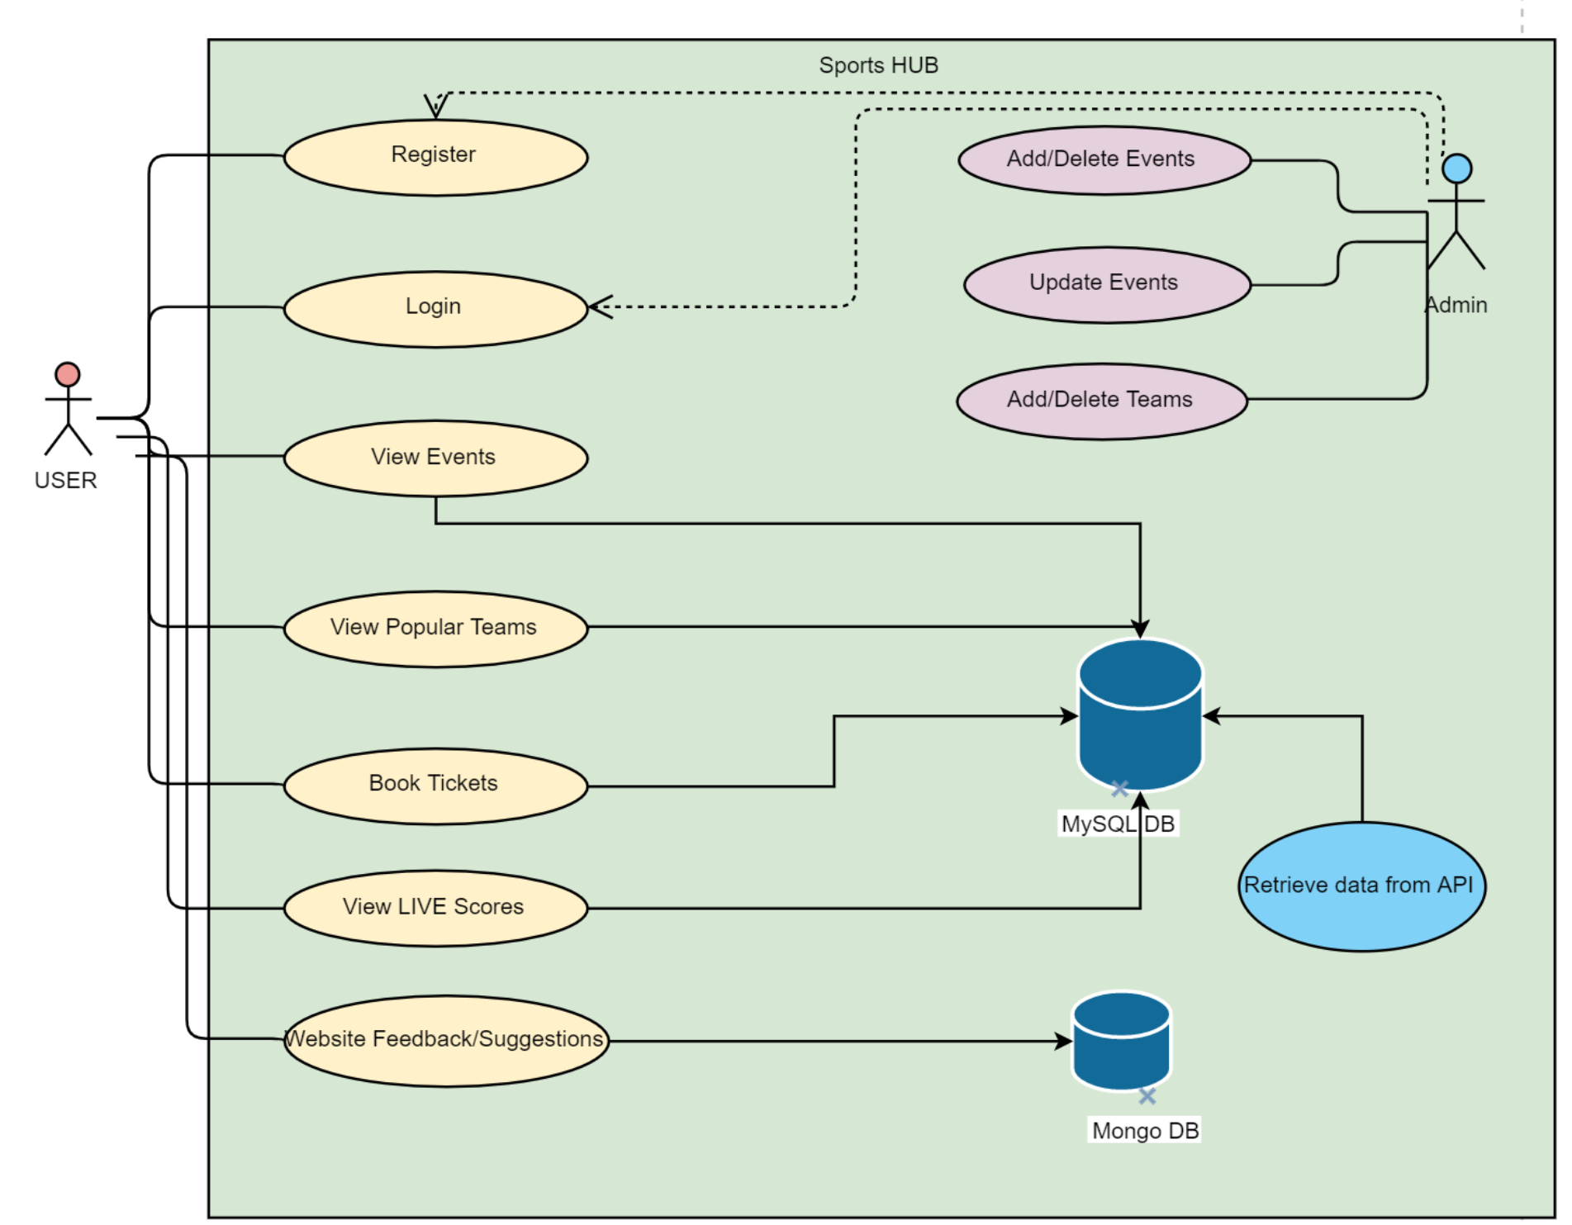

Slide 5
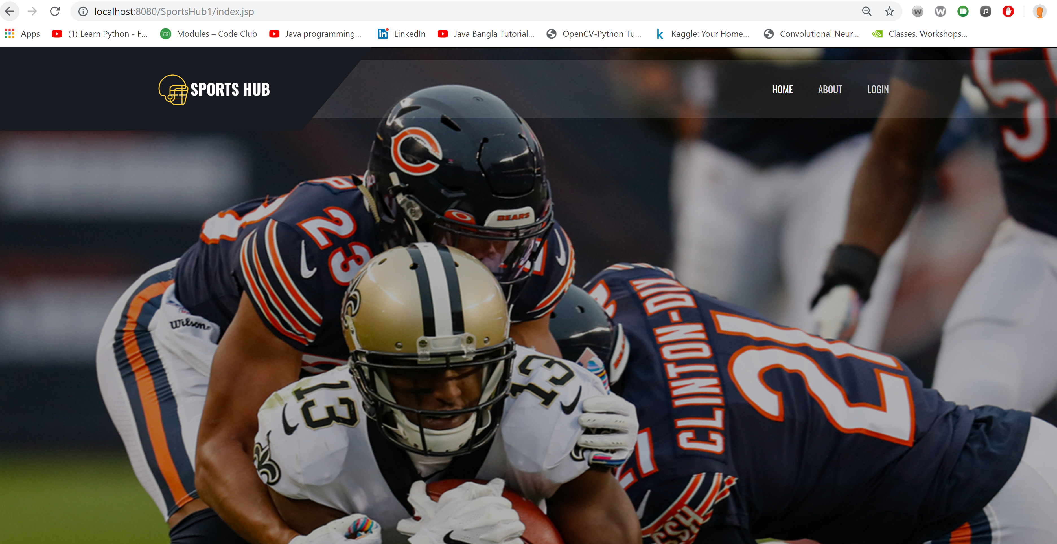

Slide 6
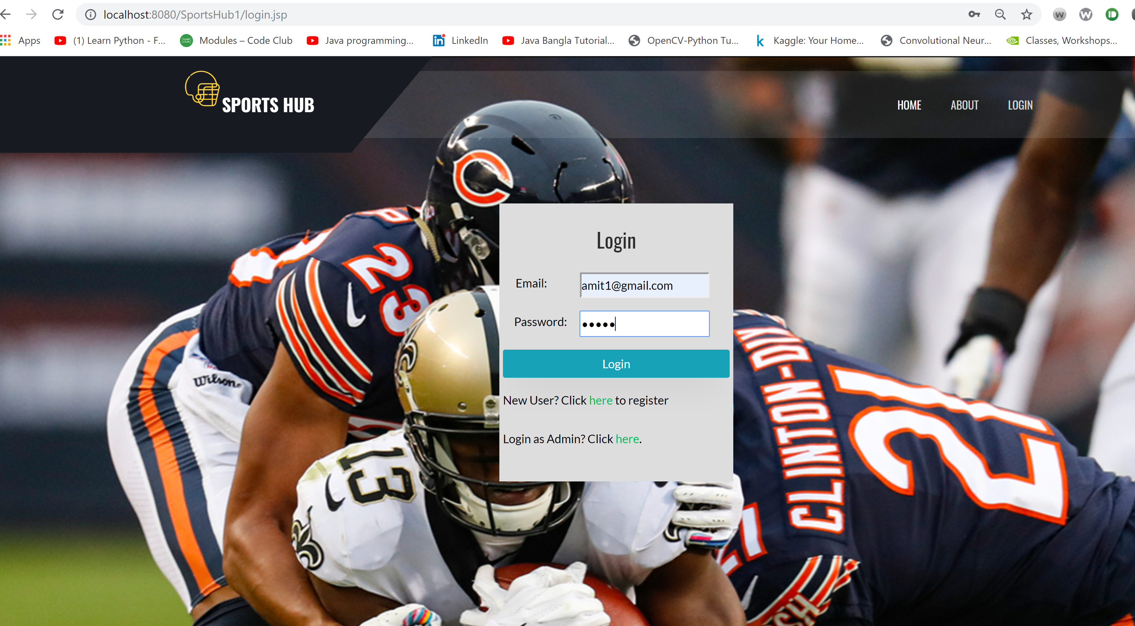

Slide 7
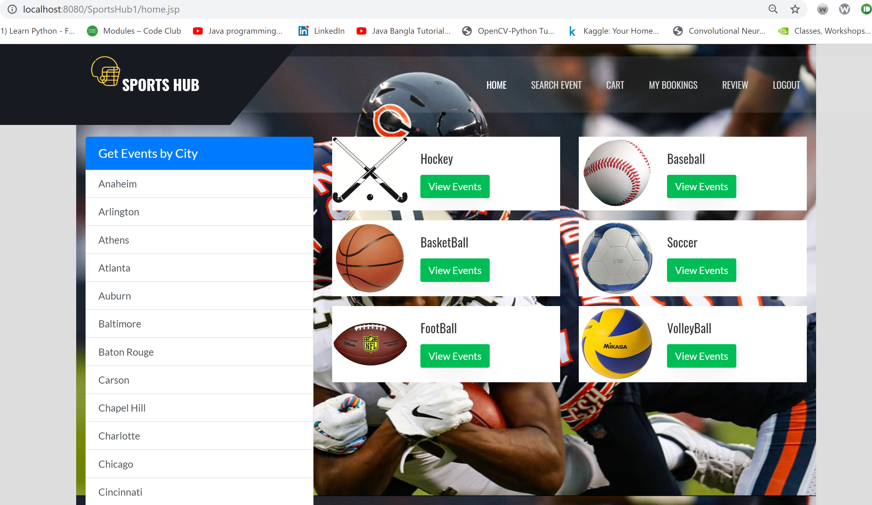
User Home Dashboard:

Slide 8
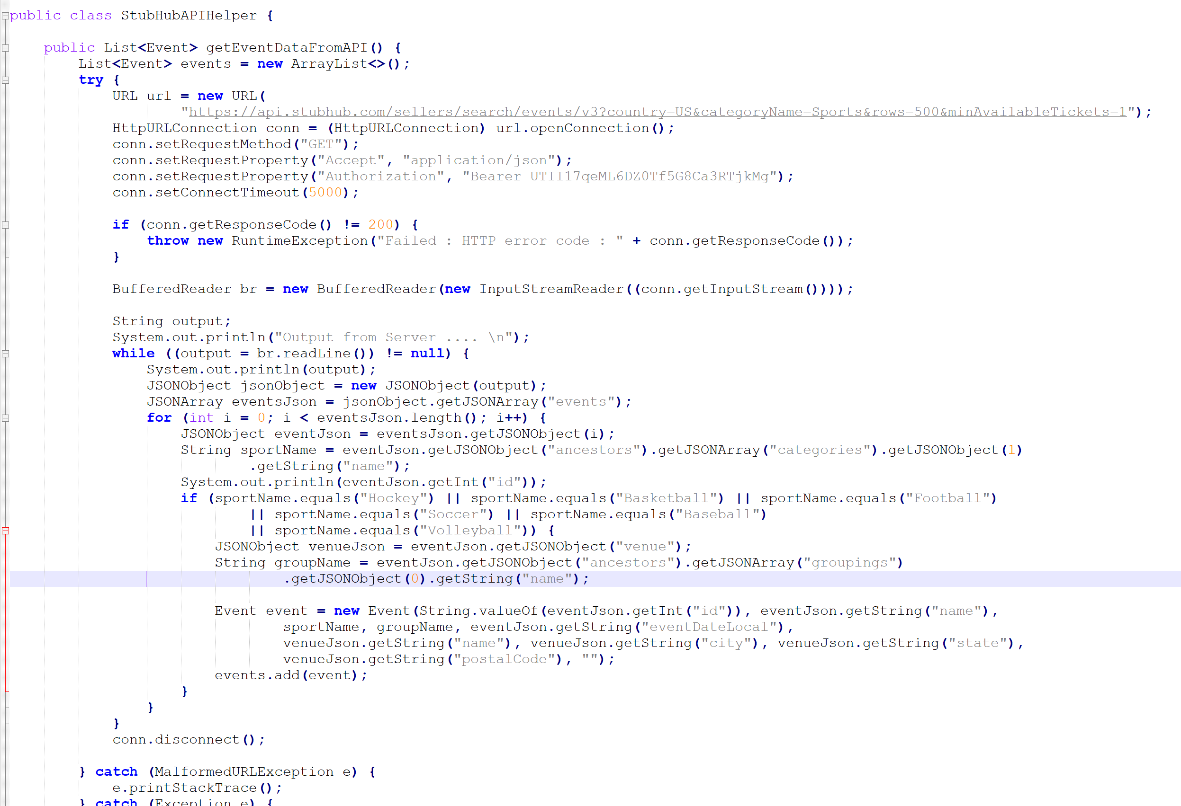
API Helper Java Code: Fetches the data from the API and stores into List Events

Slide 9
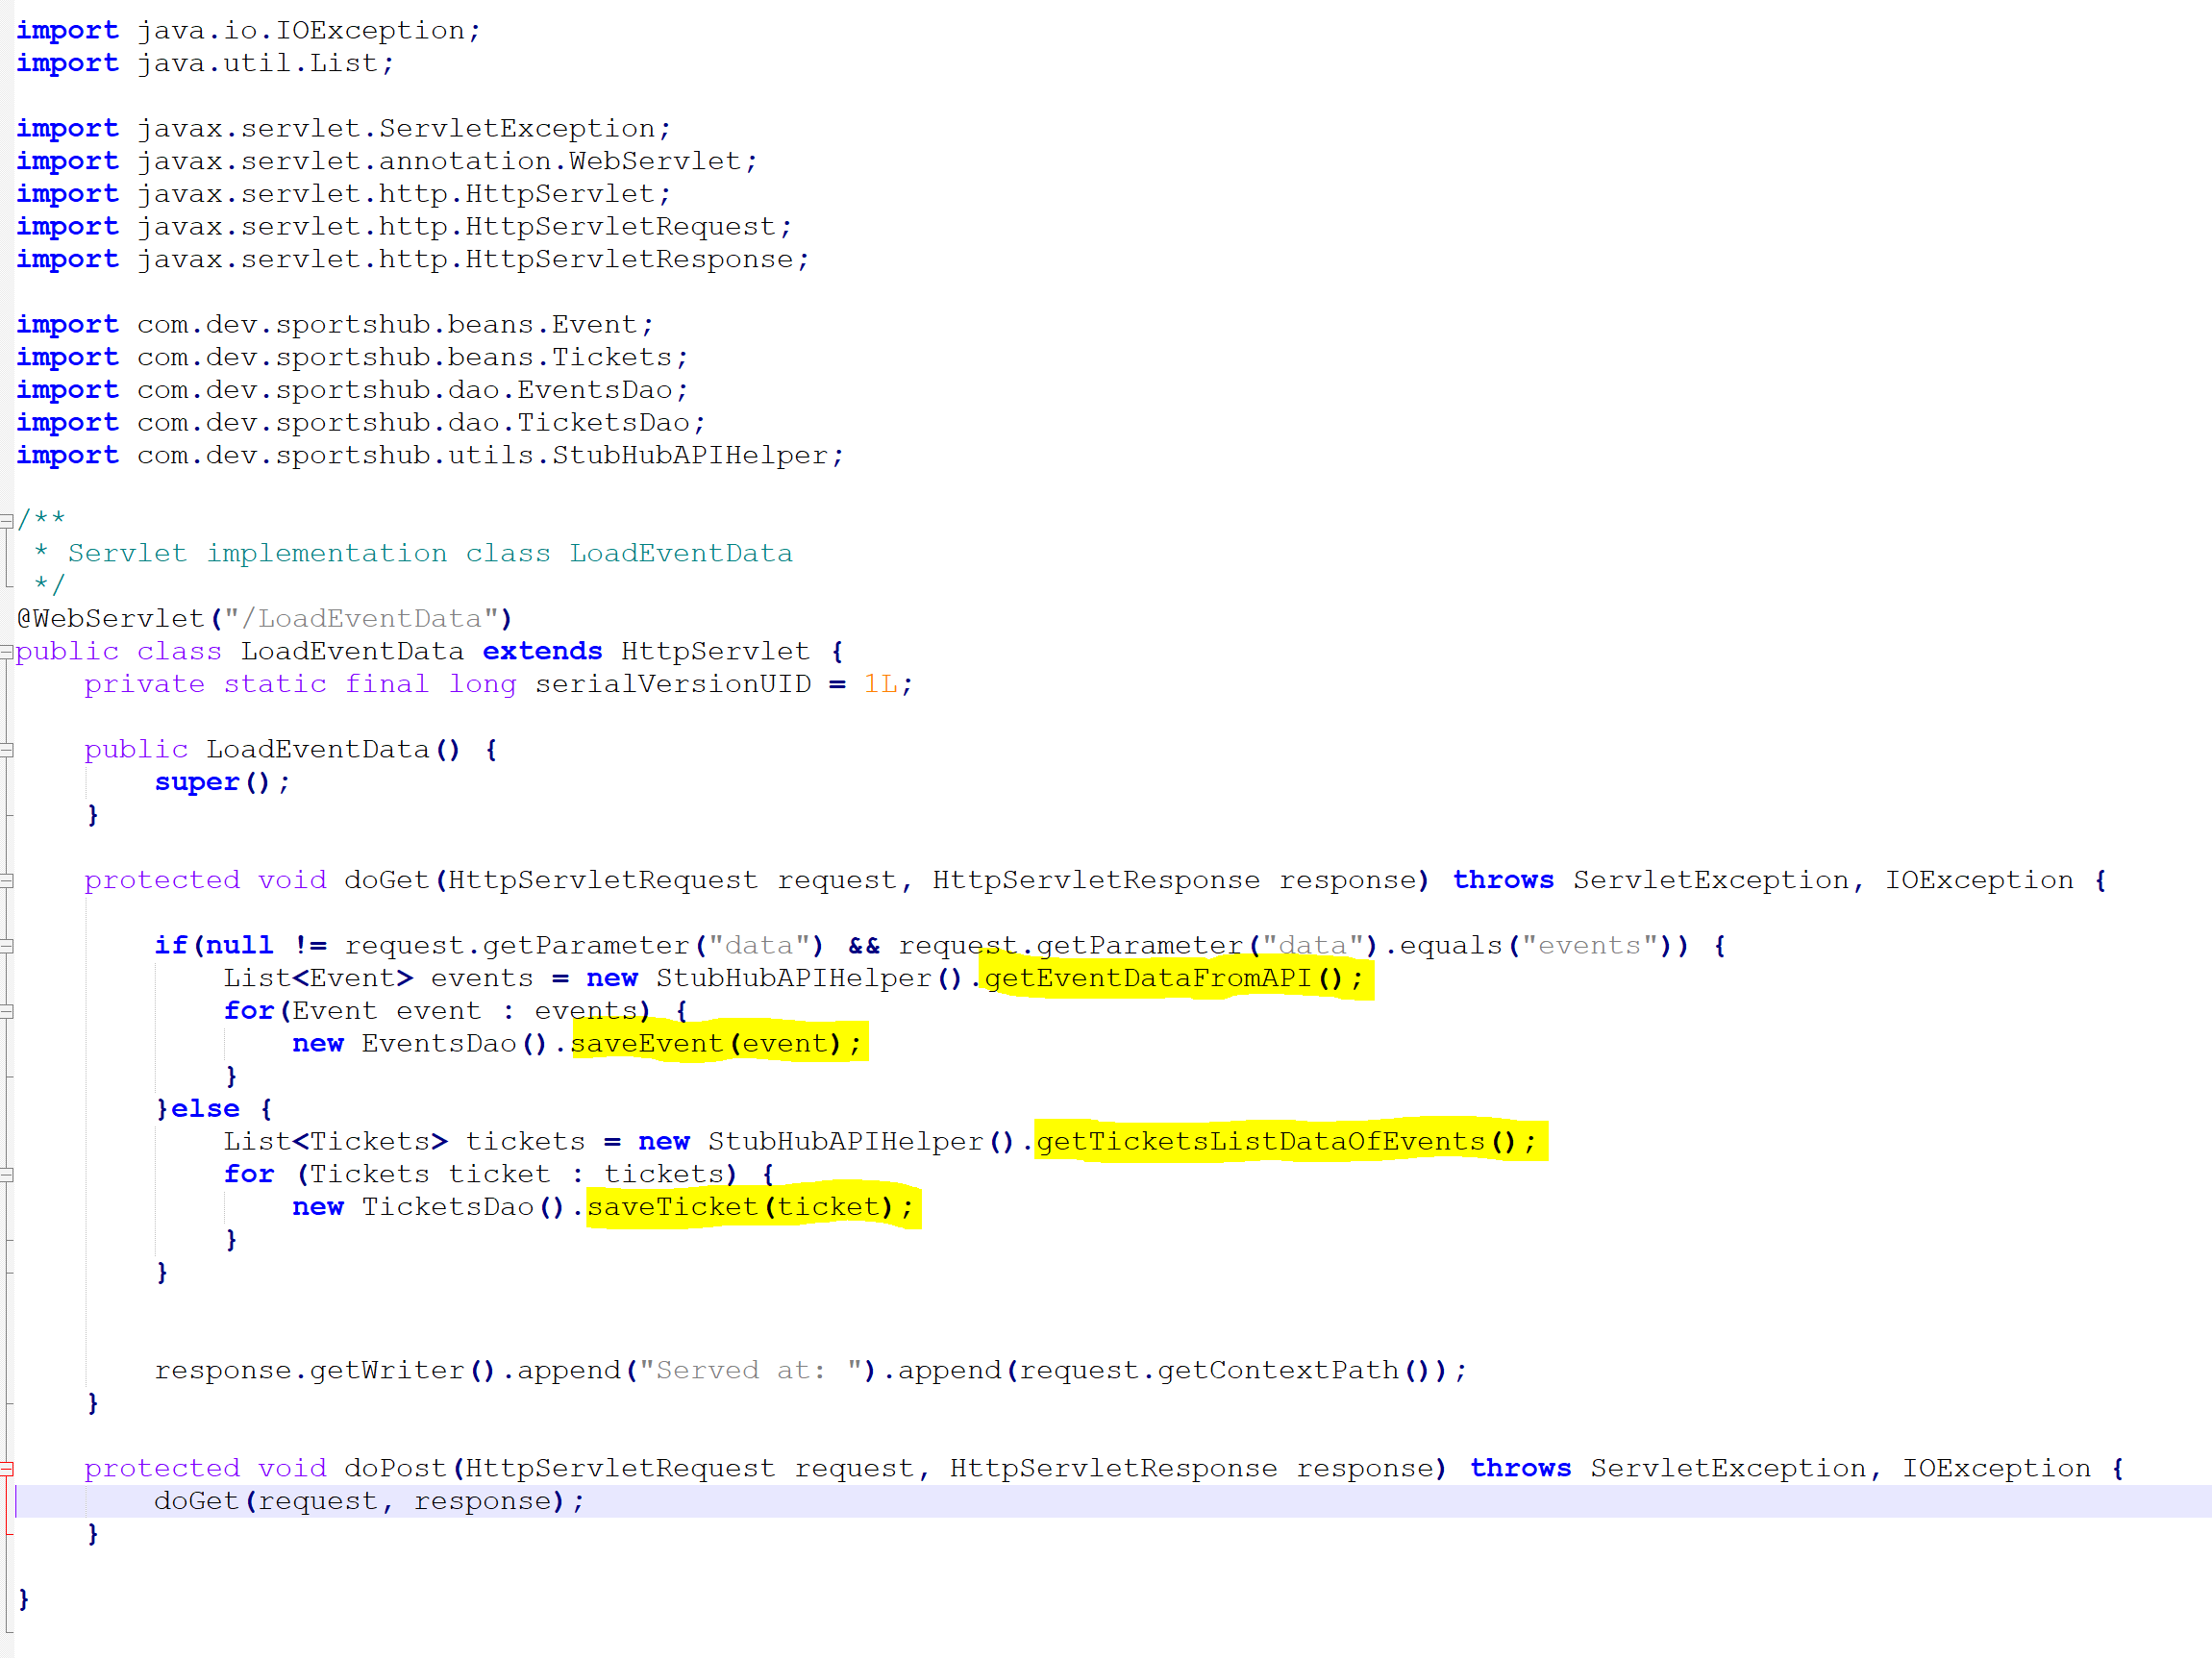
LoadEventData Servlet is used to hit the API and fetch all the events and listings data

Slide 10
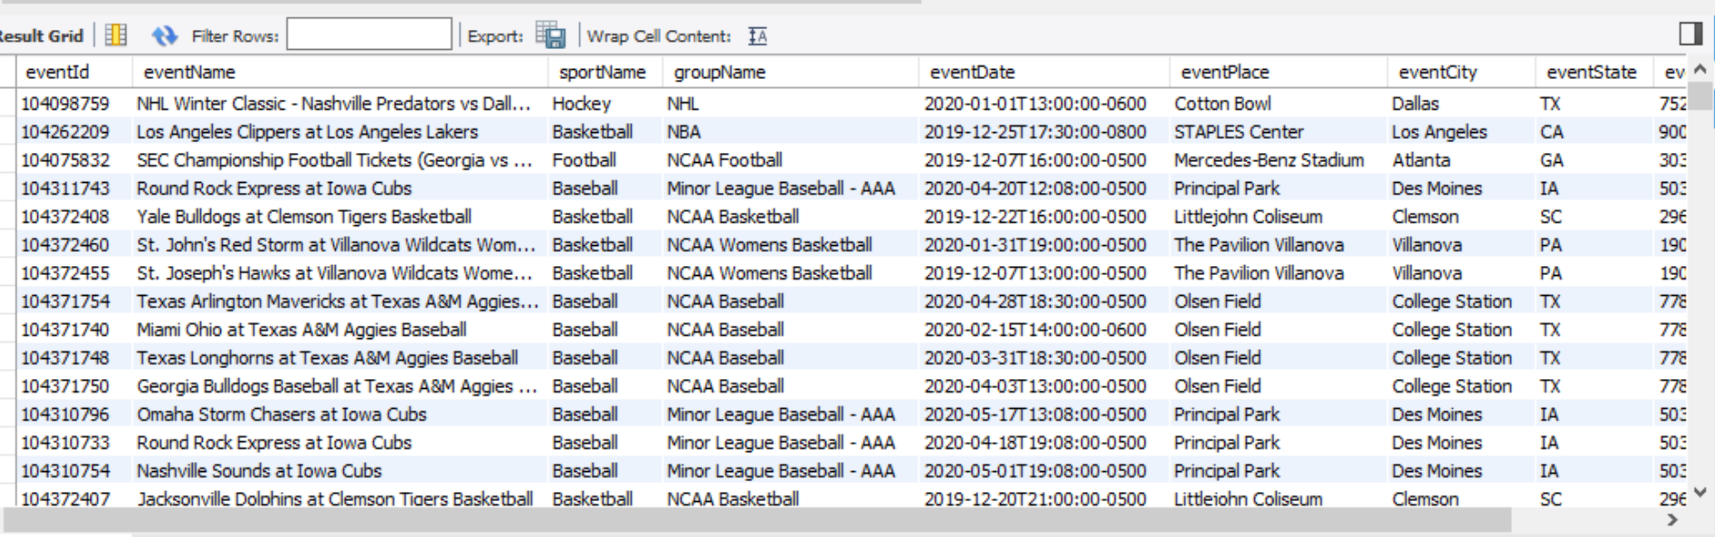
The eventsCatalog table in Database

Slide 11
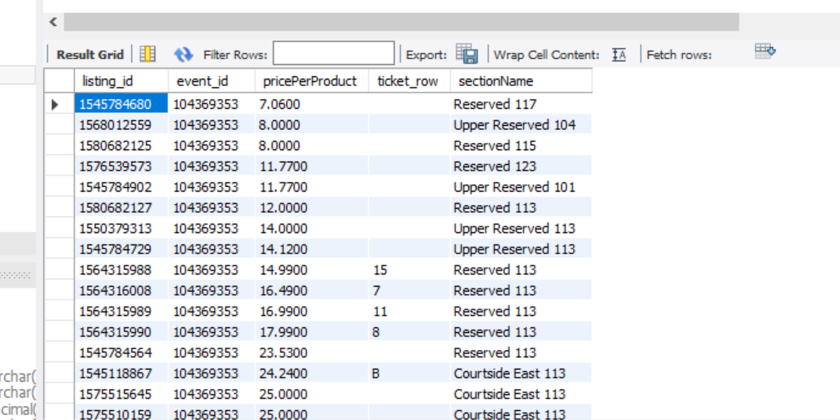
Tickets table in the MySql Database

Slide 12
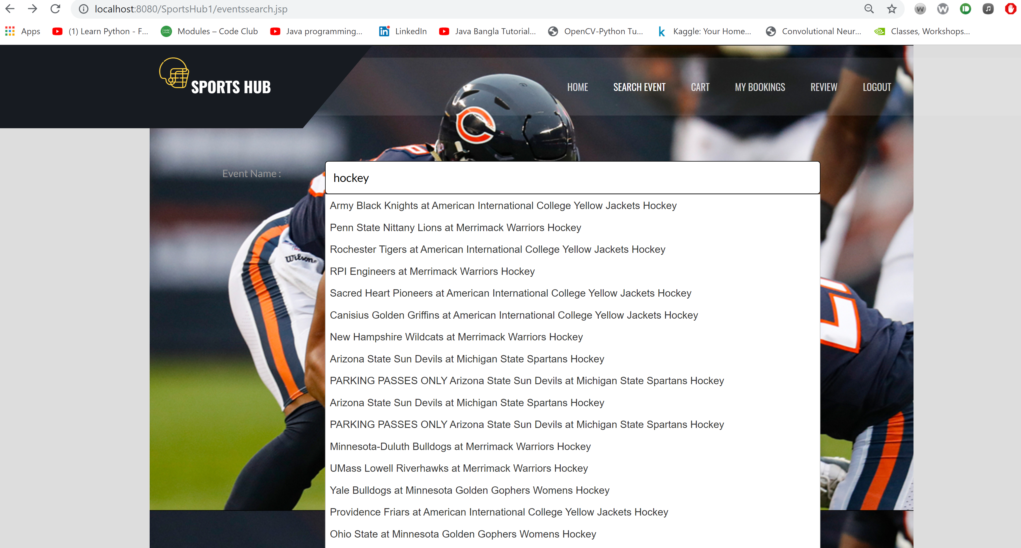
Event Search using AJAX

Slide 13
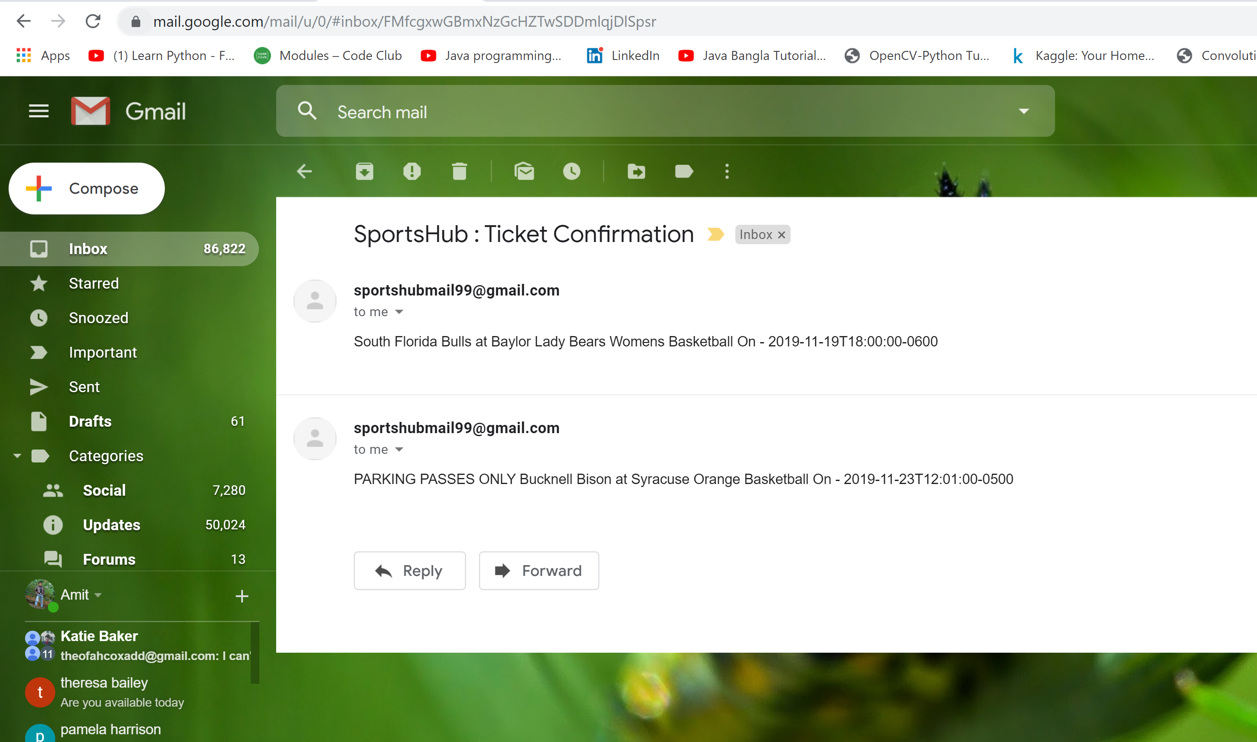
Ticket Confirmation Mail sent to the User

Slide 14
Thank You!

